Slide 1
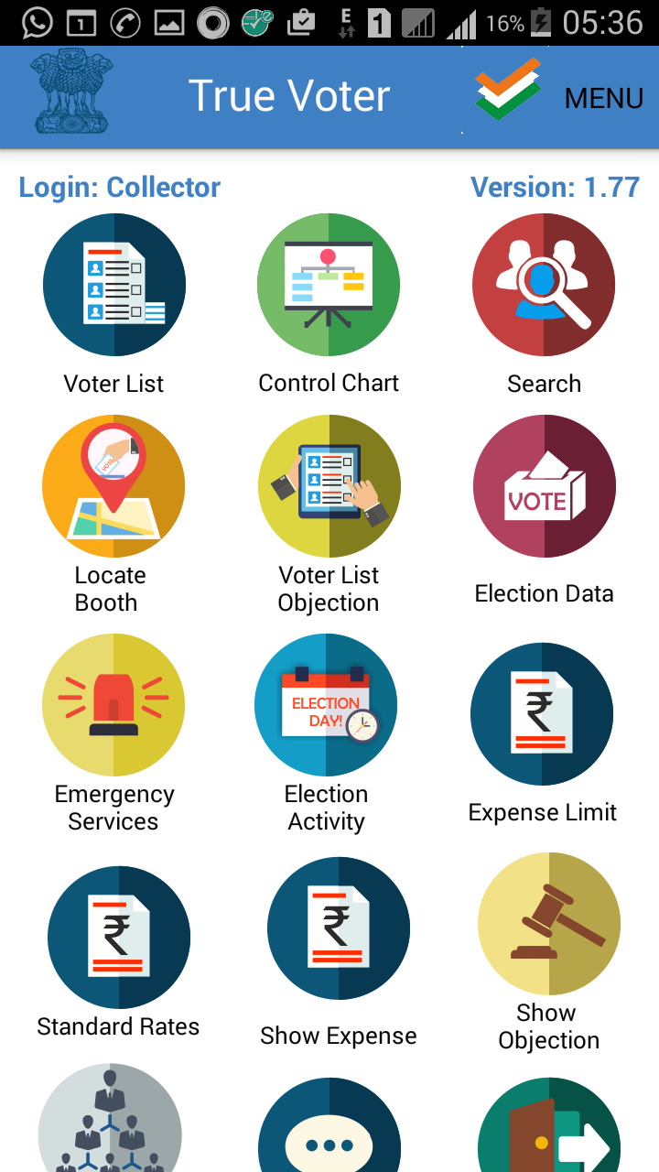
True Voter version 1.77
Remove your older version app completely from your mobile, freshly install TRUE VOTER version 1.77 and go ahead.
Always keep your app updated, to get all recent additions and corrections.
“Standard rates”
This function is used to define the Standard rates for election expense.
In officer role ‘collector’ and ‘collector staff’ for 5 types of elections and for Municipal Corporation only “Municipal commissioner” and “Municipal commissioner Staff” role persons has authority to access this function.
For 5 types of elections in every District and for every corporation there will be separate set of Standard rates and item list will be common for a district including corporations of that district .
Click on ‘Standard Rates’ button to enter the standard rate details.

Slide 2
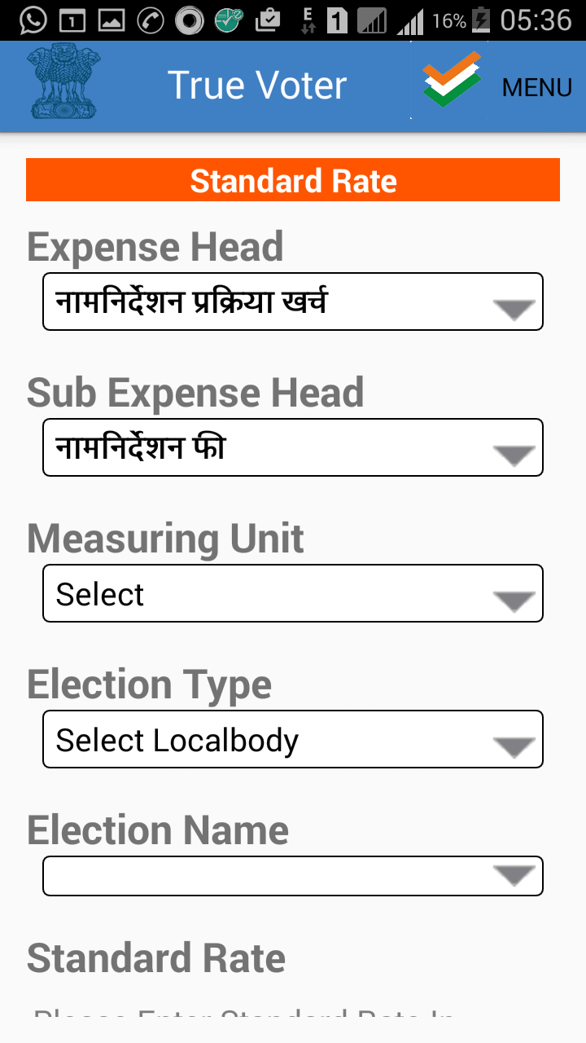
True Voter version 1.77
Standard Rate page will be displayed to the officer as in the screen shot.
Expense Head and other fields are to be properly selected

Slide 3
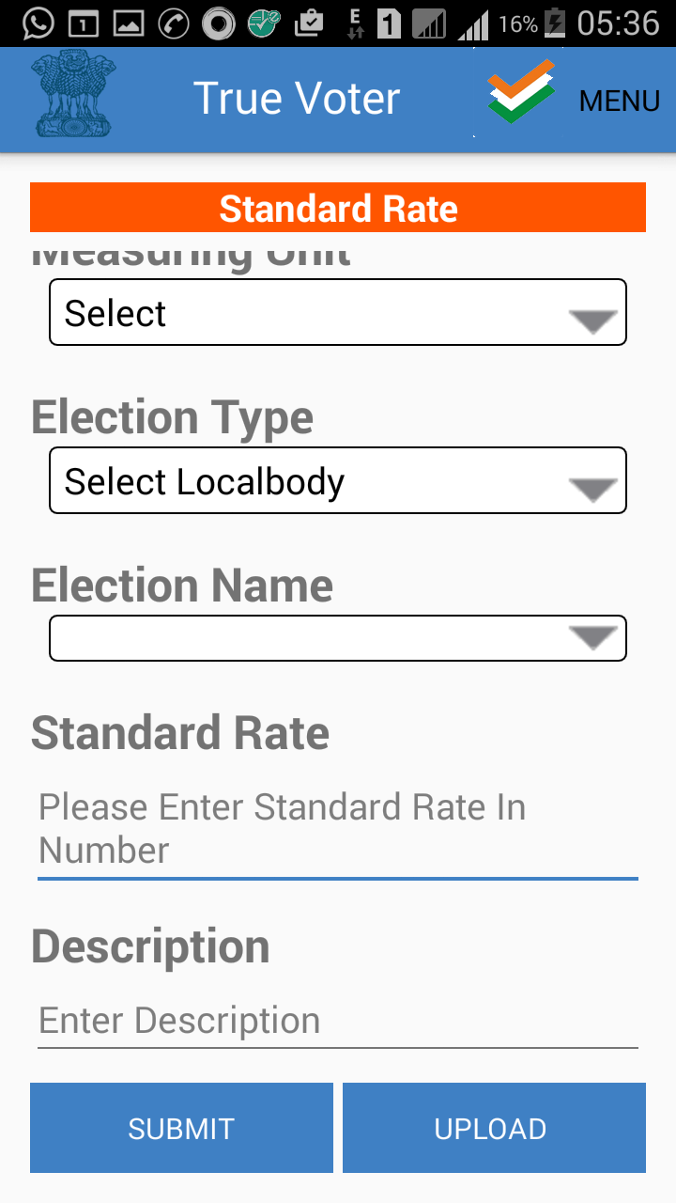
True Voter version 1.77
A big screen of standard rate can not fit in one window, so scroll down to see the “Submit” and “Upload” button.

Slide 4
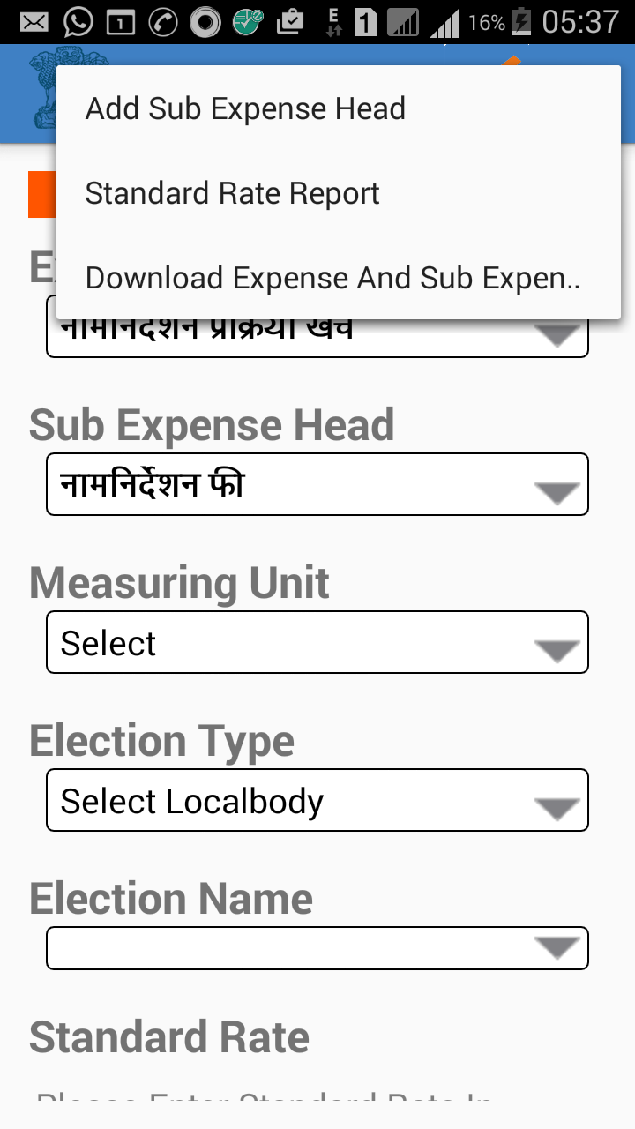
True Voter version 1.77
In right side upper corner in “MENU” there are 3 sub menus
1. Download Expense and Sub Expense Head
First download all existing sub expense head what ever that are already there for that district.
2. Add Sub Expense Head
It is used to add new sub expense heads
3. Standard Rate Report
it is used to see what ever standard rates you have added currently.

Slide 5
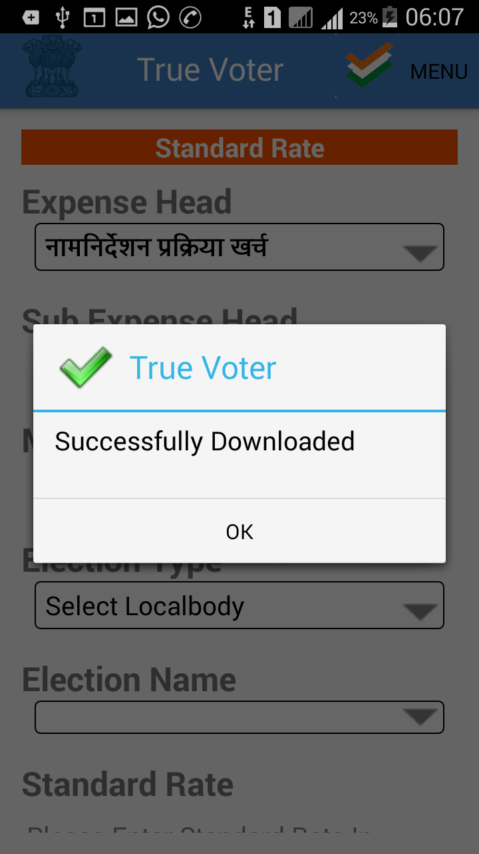
True Voter version 1.77
Download Expense and Sub Expense Head
First download all existing sub expense head what ever that are already there for that district.
After download “Successfully Downloaded” message will be displayed

Slide 6
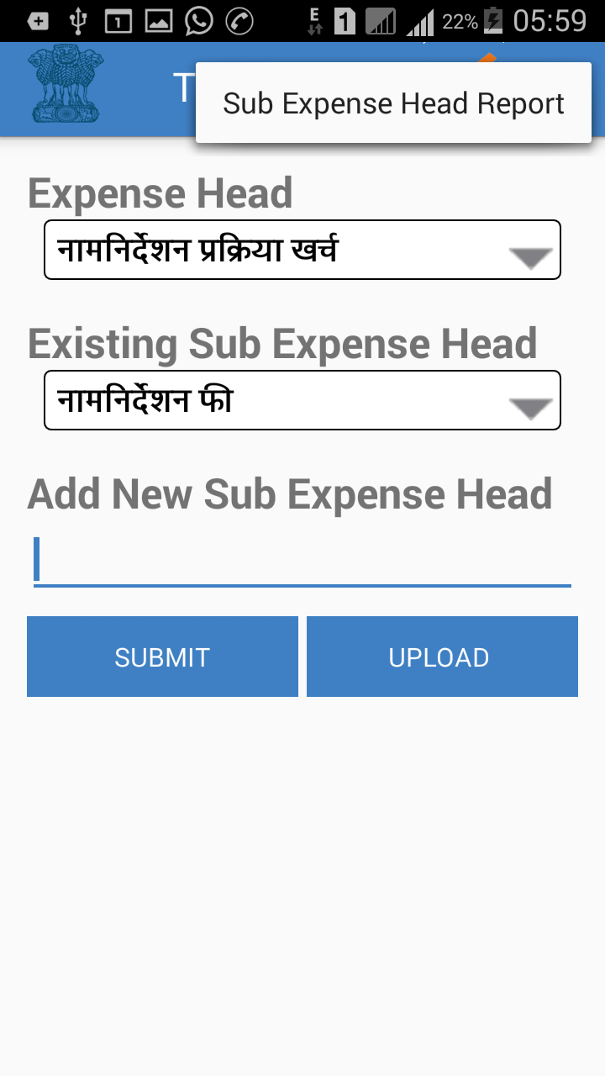
True Voter version 1.77
Add Sub Expense Head
It is used to add new sub expense heads
Add the new sub expense head, press “Submit” and then “Upload” button to upload it on server.
To see whatever sub expense head you have added, use “Sub Expense Head Report” menu of upper right corner.
Its must to upload sub expense head first to include them in main list.
“UPLOAD(1) “ the figure in bracket indicate that entry is not uploaded to server. This figure will disappear when you press “UPLOAD” button.

Slide 7
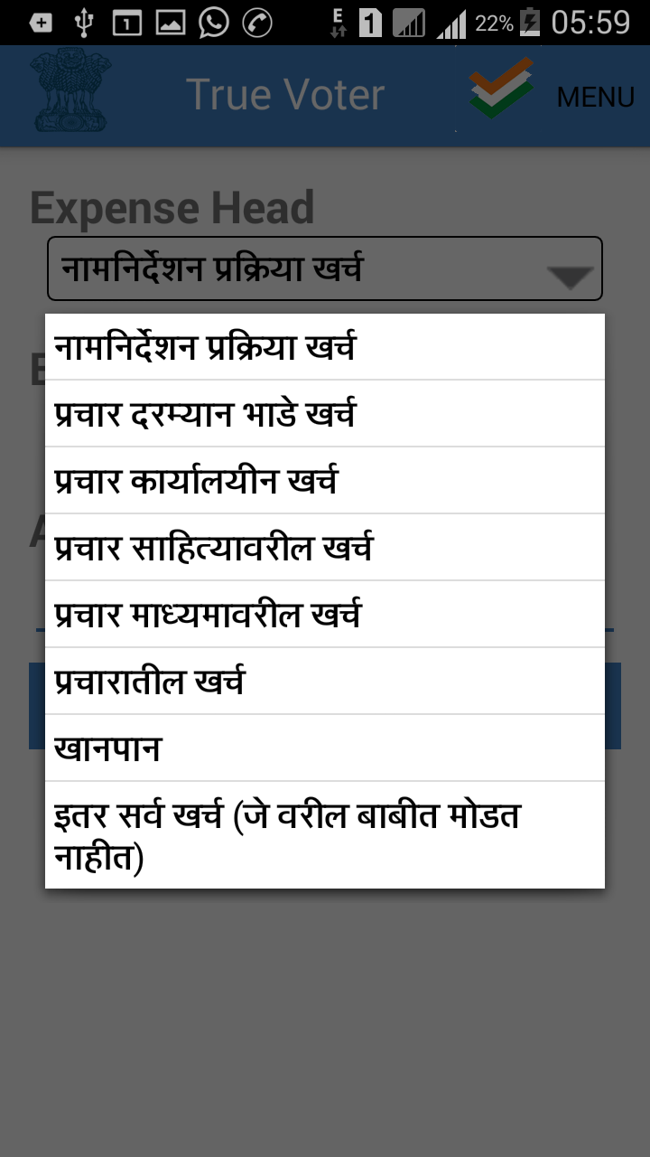
True Voter version 1.77
Expense Heads are classified in 8 group only.
Main 8 Expense heads are shown in the screen shot.
You can not add more in this group.

Slide 8
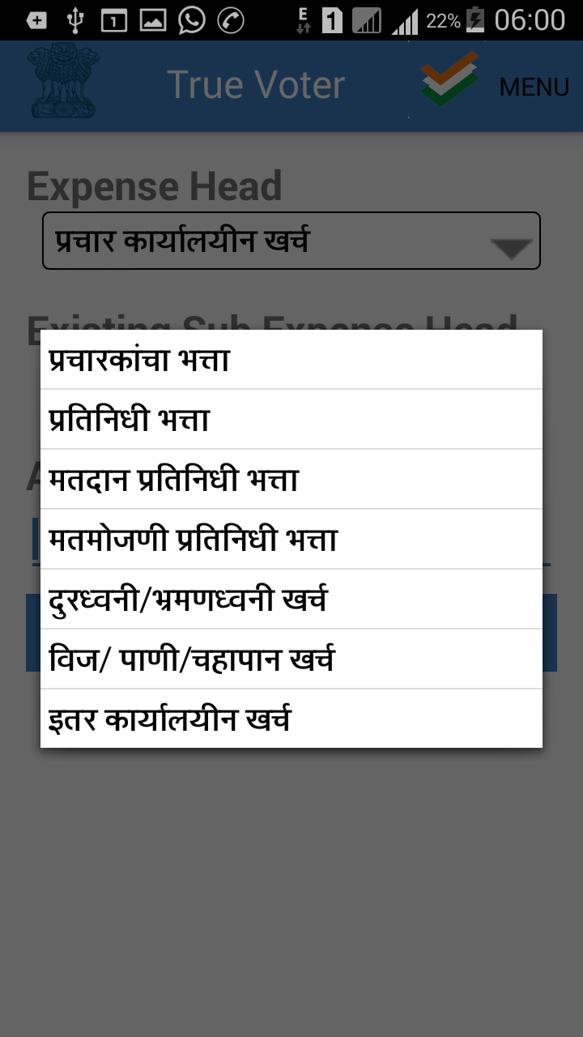
True Voter version 1.77
In each item of Main Expense Head there are sub expense head which are already defined.
You can add as many sub expense head as you require.

Slide 9
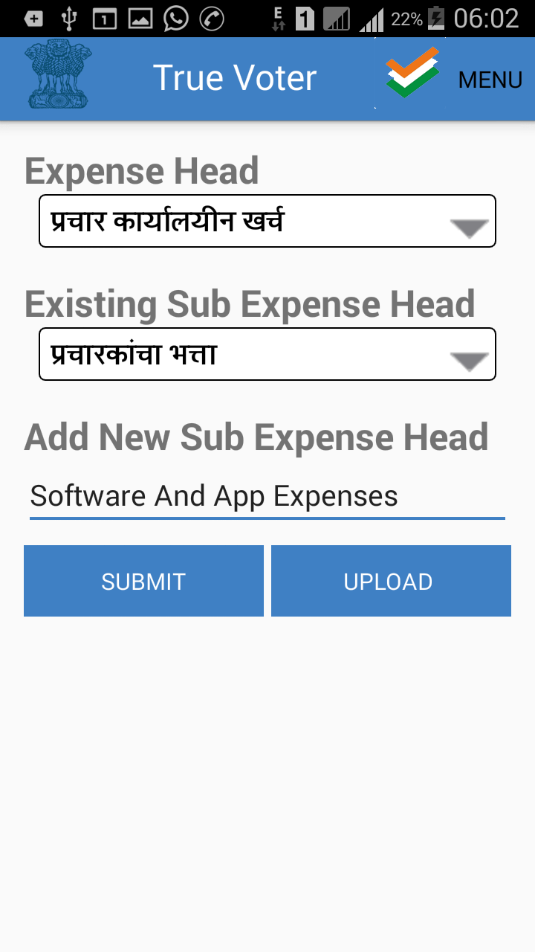
True Voter version 1.77
For example A new sub expense head “Software and App Expenses” is to be added here under main expense head “प्रचार कार्यालयीन खर्च “
You can see the existing sub expense head list of that main expense head also, so no repetition will occur.

Slide 10
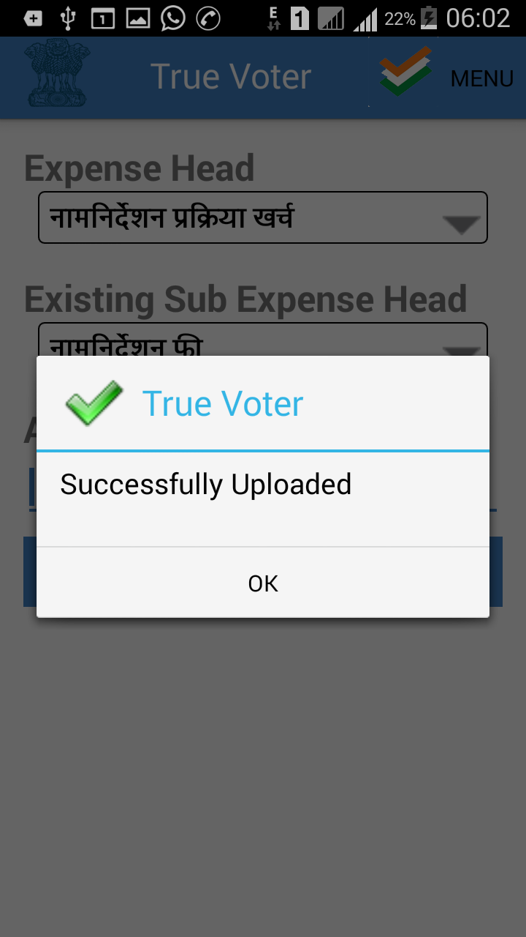
True Voter version 1.77
Its necessary to “UPLOAD” the new sub expense heads whatever you have added.
Add one by one and Upload also one by one. It will be more convenient to work.

Slide 11
True Voter version 1.77
After adding required sub expense heads and uploading also, to see them on the main page of filling standard rates, you will have to use last menu “download Expense And Sub Expense Heads” again.

Slide 12
True Voter version 1.77
After pressing “download Expense And Sub Expense Heads” , you will get the message “Successfully Downloaded”. Press “OK” to continue.

Slide 13
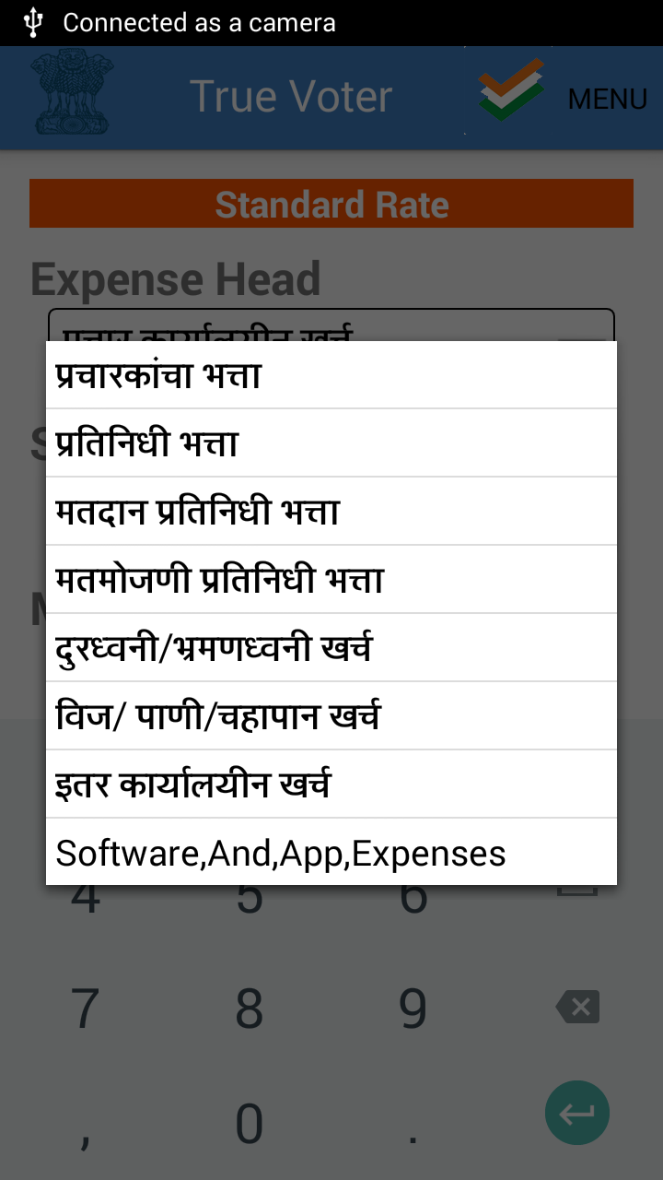
True Voter version 1.77
Your Newly added expense sub head will be displayed in the related main expense head items. Here “Software and App Expenses” is seen.
After download also if you are not getting your added sub head then just come back on the main login page and again open “Standard Rates” menu then you will find your added sub expense head. It may be due to the problem of reloading of item list.

Slide 14
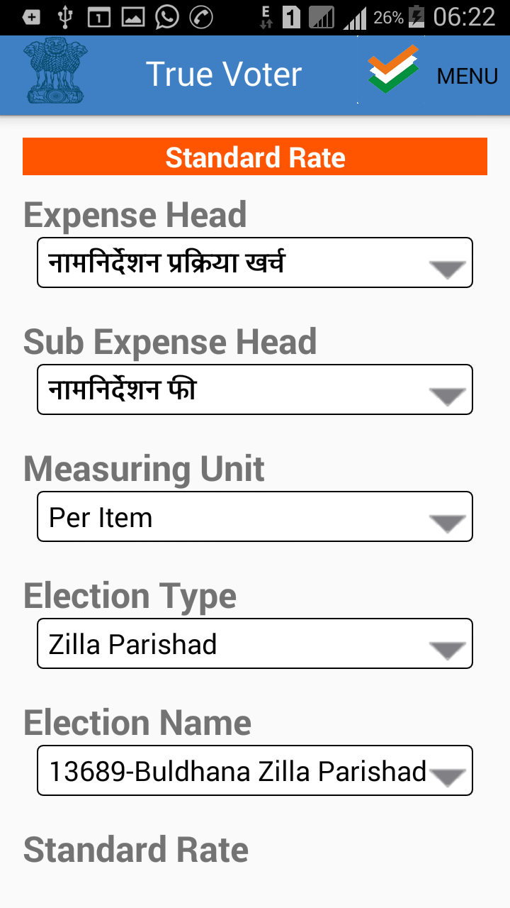
True Voter version 1.77
As various elections are always going on, now provision of filling standard rates as per type of election is given.
There is no need to fill separate rates for “Panchayat Samiti” Election.
Only Fill rates for “Zilla Parishad” Election. That will be applicable for both.
But For each Municipal Corporation standard rates will be different.

Slide 15
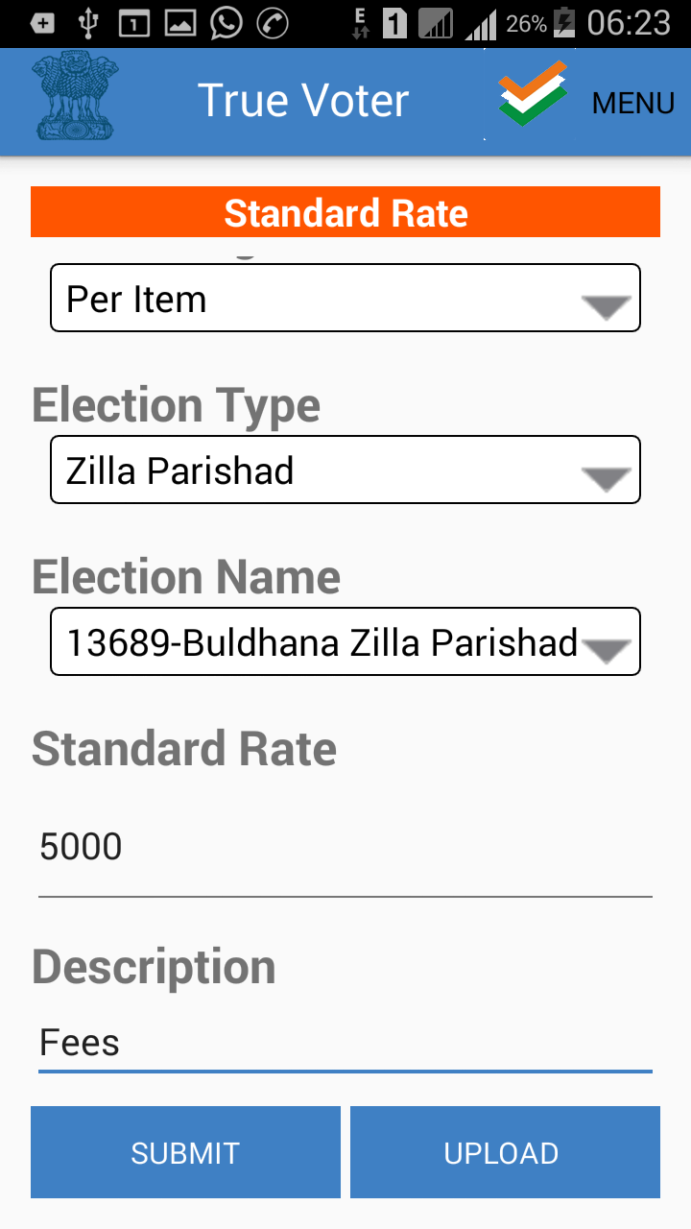
True Voter version 1.77
Standard rates are to be added in numeric values only.
Give the detail description as max as possible so that the candidate will have clear idea about it while filling his daily expenses.
Submit the standard rate entry.
Upload only if u find it accurate.

Slide 16
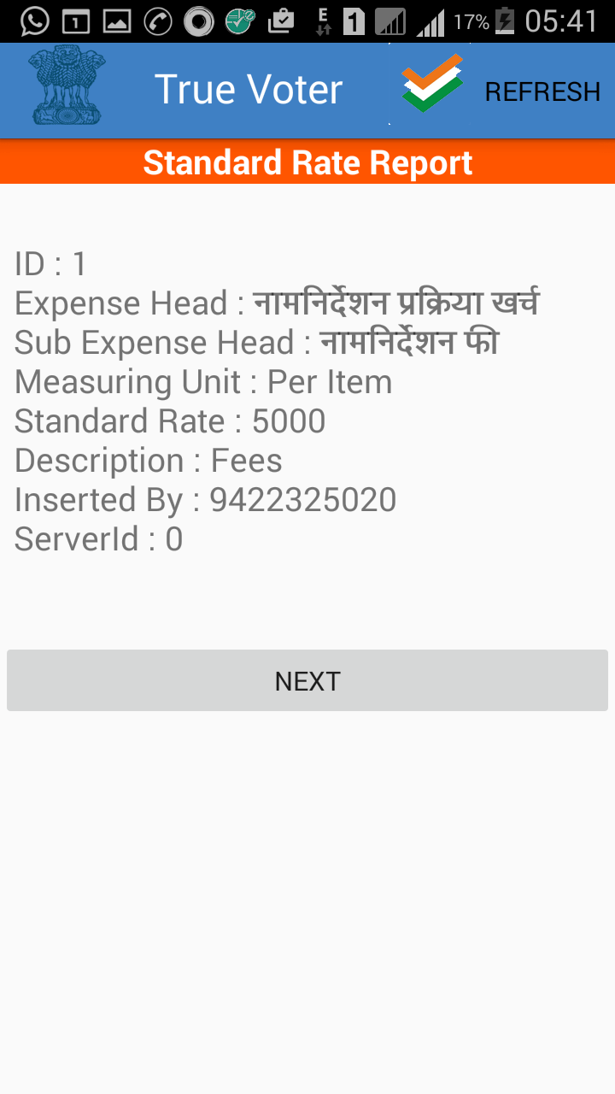
True Voter version 1.77
From Upper right side corner “MENU” click on “Standard Rate Report” to see your added entry.
U can update your added entry by clicking on it.
U can delete the entry by long pressing it.
This is only possible till server id is “0” before upload.
Once u upload the entry then u can not change it.

Slide 17
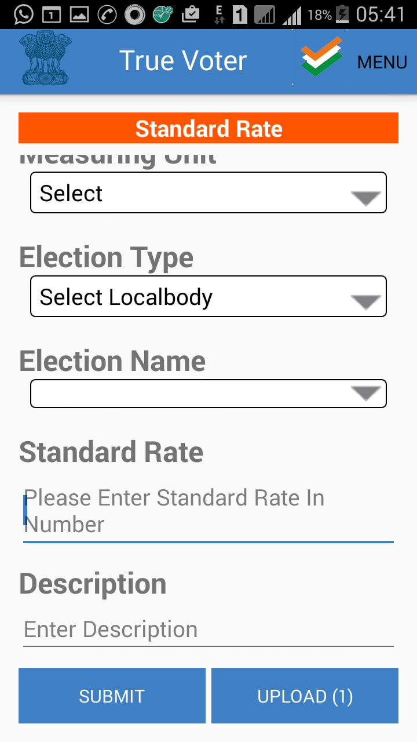
True Voter version 1.77
After addition of one entry, you will find UPLOAD(1), it means one entry is not uploaded to server.
First check it again from upper right side “MENU” through “Standard Rate Report”. Get it corrected if required. Then uploaded.
Once u upload then u can not change it.

Slide 18
True Voter version 1.77
When you press “UPLOAD” button to upload your added standard rate entry then u will get this message

Slide 19
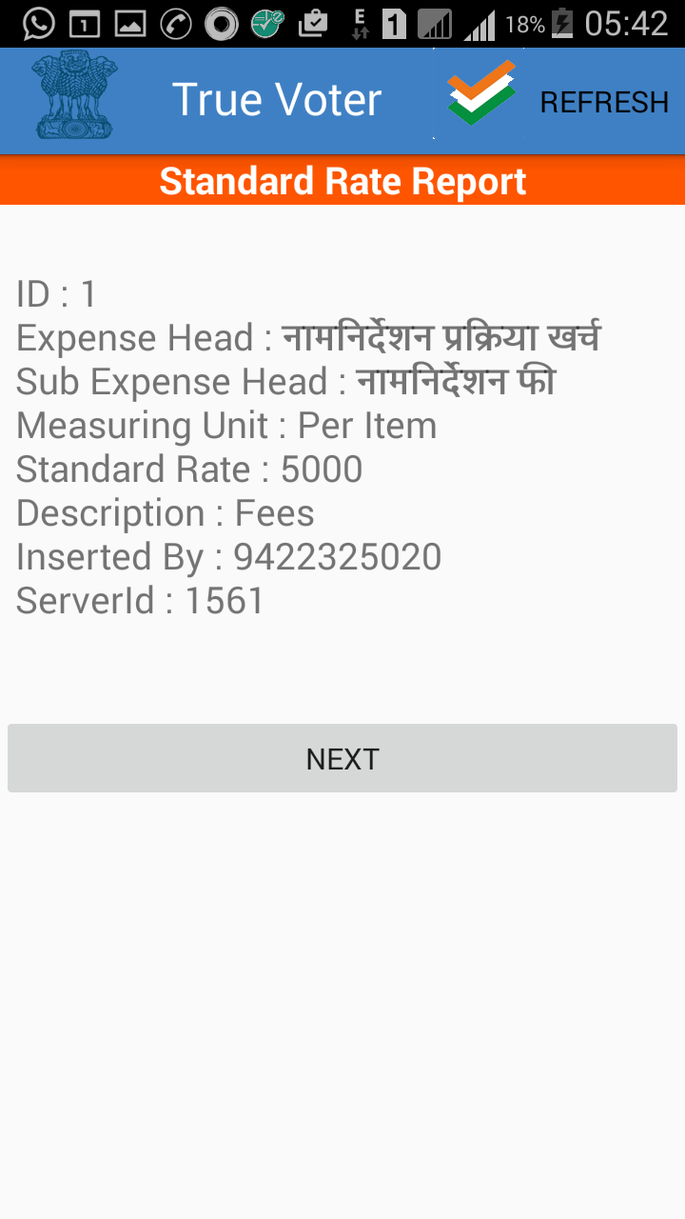
True Voter version 1.77
To confirm whether the standard rate entry is uploaded or not, you can check it by checking its server id.
Here in example : 1561

Slide 20
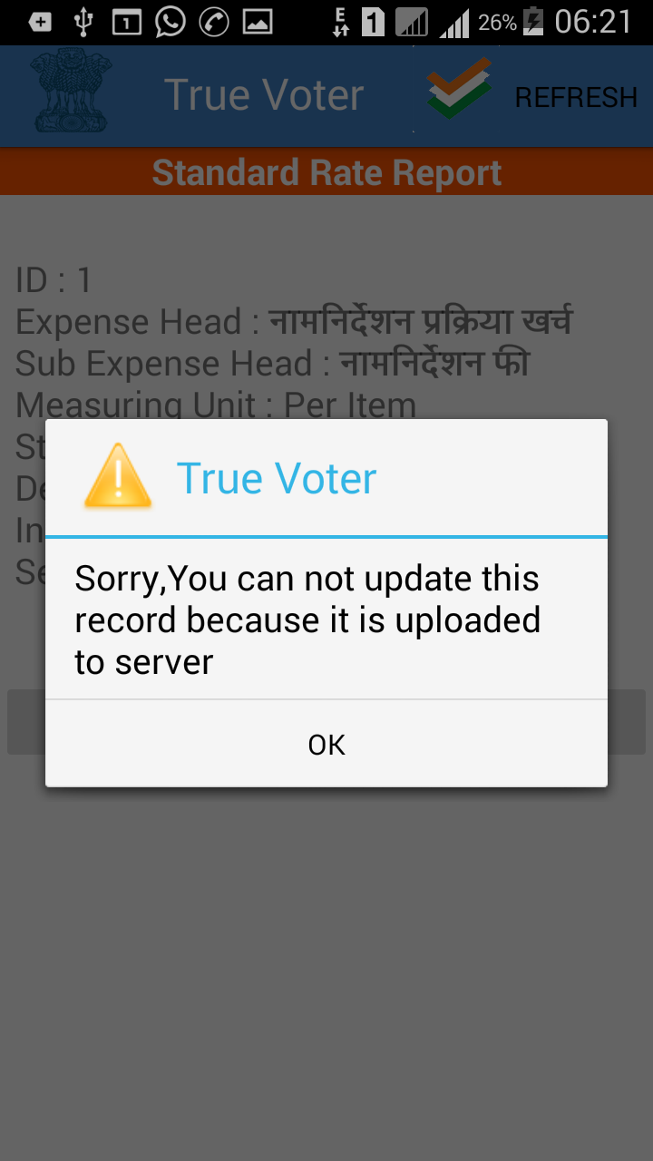
True Voter version 1.77
Once u upload it to server, once u get there server id then u can not update that entry.
For any technical support from Abhinav IT Solutions write us on truevoter@maharashtra.gov.in.
For support Call any one no out of 7447455861 to 7447455870 series.
Thanks
Prof. Murlidhar Bhutada,
(9422325020)
Managing Director,
Abhinav IT Solutions Pvt. Ltd.

